Slide 1

DATA SCIENCE CONSULTING Session 8
March 12th, 2019

Slide 2

Agenda
Semi-supervised recap
Data to business transition
Business workshop
Agile methodology
Conclusion

Slide 3
Semi-supervised learning : how it works
Procedure to use :
Train your data with X_train
Evaluate the model with X_test
Make a propagation on a small set of unlabeled data
Relabel the non-confident results
Use your relabeled data and the confident labelised data to make a new X_train
Predict on the next small-set of unlabeled data
Do it until the end of the dataset
Trade-off :
Lots of iterations : time consuming for labelisation but confidence will be higher
Few iterations : faster to compute but lower confidence in the model
Review | Other info | Labels
Nice! | … | 0
Good | … | 1
Hate it | … | 1
… | … | 0
Cool | …
Nice Food | …
… | …
… | …
… | …
… | …
… | …
Best! | …
Labeled
data
X_train
X_test
Unlabeled
data

Slide 4
Semi-supervised learning : propagation results
review_id | rating | hotel_name | trip_date | published_date | service | activities | cost | family | food | infrastructure | service_sentiment | activities_sentiment | cost_sentiment | family_sentiment | food_sentiment | infra_sentiment
0 | 4 | Sherwood Forest | 01/10/2011 | 31/10/2011 | 1.0 | 1.0 | 1.0 | 0.0 | 1.0 | 1.0 | 2.0 | 2.0 | 0.0 |  | 2.0 | 0.0
1 | 3 | Sherwood Forest | 01/02/2019 | 14/02/2019 | 1.0 | 0.0 | 1.0 | 0.0 | 0.0 | 1.0 | 2.0 |  | 0.0 |  |  | 0.0
2 | 5 | Sherwood Forest | 01/02/2019 | 16/02/2019 | 1.0 | 1.0 | 0.0 | 1.0 | 0.0 | 1.0 | 2.0 | 2.0 |  | 2.0 |  | 2.0
4 | 5 | Elveden Forest | 01/02/2019 | 14/02/2019 | 1.0 | 1.0 | 1.0 | 0.0 | 0.0 | 1.0 | 2.0 | 2.0 | 0.0 |  |  | 2.0
5 | 5 | Sherwood Forest | 01/02/2019 | 15/02/2019 | 1.0 | 1.0 | 1.0 | 0.0 | 0.0 | 1.0 | 2.0 | 2.0 | 0.0 |  |  | 2.0
7 | 4 | Elveden Forest | 01/02/2019 | 14/02/2019 | 1.0 | 1.0 | 1.0 | 0.0 | 1.0 | 1.0 | 2.0 | 2.0 | 0.0 |  | 0.0 | 0.0
9 | 5 | Elveden Forest | 01/01/2019 | 15/02/2019 | 1.0 | 1.0 | 1.0 | 0.0 | 0.0 | 1.0 | 2.0 | 2.0 | 0.0 |  |  | 0.0
10 | 5 | Elveden Forest | 01/02/2019 | 15/02/2019 | 1.0 | 0.0 | 1.0 | 0.0 | 1.0 | 1.0 | 2.0 |  | 0.0 |  | 0.0 | 0.0
11 | 4 | Sherwood Forest | 01/02/2019 | 13/02/2019 | 1.0 | 1.0 | 0.0 | 0.0 | 0.0 | 1.0 | 2.0 | 2.0 |  |  |  | 0.0
12 | 5 | Sherwood Forest | 01/02/2019 | 13/02/2019 | 1.0 | 1.0 | 0.0 | 1.0 | 0.0 | 1.0 | 2.0 | 2.0 |  | 2.0 |  | 2.0
13 | 5 | Sherwood Forest | 01/02/2019 | 13/02/2019 | 1.0 | 1.0 | 0.0 | 0.0 | 0.0 | 1.0 | 2.0 | 2.0 |  |  |  | 2.0
14 | 4 | Sherwood Forest | 01/01/2019 | 14/02/2019 | 1.0 | 1.0 | 1.0 | 0.0 | 1.0 | 1.0 | 2.0 | 2.0 | 0.0 |  | 0.0 | 2.0
15 | 5 | Elveden Forest | 01/02/2019 | 13/02/2019 | 1.0 | 1.0 | 0.0 | 1.0 | 0.0 | 1.0 | 2.0 | 2.0 |  | 2.0 |  | 2.0
16 | 5 | Sherwood Forest | 01/01/2019 | 13/02/2019 | 1.0 | 1.0 | 1.0 | 0.0 | 1.0 | 1.0 | 2.0 | 2.0 | 0.0 |  | 0.0 | 2.0
17 | 5 | Elveden Forest | 01/02/2019 | 13/02/2019 | 1.0 | 1.0 | 0.0 | 1.0 | 0.0 | 1.0 | 2.0 | 2.0 |  | 2.0 |  | 2.0
18 | 5 | Elveden Forest | 01/02/2019 | 14/02/2019 | 1.0 | 1.0 | 1.0 | 0.0 | 1.0 | 1.0 | 2.0 | 2.0 | 0.0 |  | 2.0 | 2.0
19 | 3 | Elveden Forest | 01/02/2019 | 14/02/2019 | 1.0 | 1.0 | 1.0 | 0.0 | 0.0 | 1.0 | 2.0 | 2.0 | 0.0 |  |  | 0.0
20 | 4 | Elveden Forest | 01/02/2019 | 14/02/2019 | 1.0 | 0.0 | 1.0 | 1.0 | 1.0 | 1.0 | 2.0 |  | 0.0 | 2.0 | 0.0 | 2.0
23 | 5 | Sherwood Forest | 01/01/2019 | 12/02/2019 | 1.0 | 1.0 | 1.0 | 1.0 | 0.0 | 1.0 | 2.0 | 2.0 | 0.0 | 2.0 |  | 2.0
24 | 4 | Sherwood Forest | 01/01/2019 | 12/02/2019 | 1.0 | 1.0 | 1.0 | 1.0 | 1.0 | 1.0 | 2.0 | 2.0 | 0.0 | 2.0 | 2.0 | 2.0
26 | 4 | Elveden Forest | 01/02/2019 | 13/02/2019 | 1.0 | 1.0 | 0.0 | 1.0 | 0.0 | 1.0 | 2.0 | 2.0 |  | 2.0 |  | 0.0
27 | 4 | Elveden Forest | 01/02/2019 | 12/02/2019 | 1.0 | 1.0 | 1.0 | 1.0 | 0.0 | 1.0 | 2.0 | 2.0 | 0.0 | 2.0 |  | 2.0
28 | 3 | Elveden Forest | 01/02/2019 | 13/02/2019 | 1.0 | 0.0 | 1.0 | 1.0 | 0.0 | 1.0 | 2.0 |  | 0.0 | 2.0 |  | 2.0
29 | 3 | Elveden Forest | 01/02/2019 | 12/02/2019 | 1.0 | 1.0 | 1.0 | 0.0 | 0.0 | 1.0 | 0.0 | 2.0 | 0.0 |  |  | 0.0
30 | 3 | Elveden Forest | 01/02/2019 | 12/02/2019 | 1.0 | 1.0 | 0.0 | 0.0 | 0.0 | 1.0 | 2.0 | 2.0 |  |  |  | 2.0
just back from a fabulous holiday love the concept and everything that centre parcs has to offer sadly sherwood needs some love and upgrading our lodge was fine but a bit shabby in places the outside of it had moss and the wood was tainted and dank lighting inadequate in the evening and too many cars and vehicles on the roads were you were walking or riding your bikes aware there was work being done in the pool area but the main pool &amp
well what a blast we had it was our first visit to sherwood forest and we couldnt fault anything the staff on the whole site are so pleasant and friendly and couldnt help enough the lodges we had a 3 bed for 6 people where very roomy and we had plenty of room for everyone the sub tropical pool is amazing and i would definitely recommend night swimming we fed the wild life from our hand on the patio and the grand kids loved it all in all we had a lovely totally relaxing break cant wait to book our next holiday
had a wonderful monday to friday break totally relaxing time spent in lovely peaceful surroundings we enjoy just lovely walks swimming and nice meals in the evening ud83dude00 next year will be our twenty first year we have been going so they ve obviously got it right for us anyway staff where ever you go couldn t be more polite or helpful ud83dude00ud83dude00 would highly recommend it
stayed in an executive style 2 bedroom cabin nice and clean well maintained throughout our stay kitchen area well equipped for eating in one en suite with bath and shower the other a large walk in shower plenty of activities for all ages pricing didn t seen to expensive restaurants on site all serve &quot
we arrived to a dirty executive lodge i would say for the extra you pay you are better of not bothering the stay it self was good the grandchildren had a wonderful time the pool was clean and tidy and not to over crowded
lighting at night is dangerous strongly recommend taking a torch signage is vastly inadequate especially in the dark all outlets have extortionate prices take as much food etc as you can unless you do not mind being ripped off lodge was very clean and comfortable but bedrooms on the small side they made a big issue of bike security on their hire bikes but if you take back in evening when bike centre closed you just leave it with lock and key there were at at least 30 returned bikes just laying on floor altogether and some people had not even bothered to turn the lights off on the returned bikes swimming area is great lots for all ages
it is difficult to have a relaxing break when chainsaws and jcbs are operating just outside your cabin for several hours a day there was no warning of this provided and the workmen involved did not even come to apologise for the intrusion of course they have their job to do but it doesn t seem very sound management to put people to stay in cabins where there are extensive tree works planned for those very days obviously this did rather colour our visit we were disappointed that the aerial adventure that we booked was cancelled despite the weather being calm and sunny at the time that it had been booked for we were also disappointed on the same afternoon that we couldn t have a boat ride because they had stopped running at 1430 there was no notice to this effect at the boathouse which said it was open till 1530 apart from all this we had a great time

Slide 5
Agenda
Semi-supervised recap
Data to business transition
Business workshop
Agile methodology
Conclusion

Slide 6


Brainstorm: Data to business transition
15’
Which performance indicators could you extract from your data analysis ?

Slide 7

Restitution: Data to business transition
5’
Which performance indicators could you extract from your data analysis ?

Slide 8
Brainstorm: Data to business transition
15’
How would you hierarchize the extracted topics in order to get business insights ?

Slide 9
Restitution: Data to business transition
5’
How would you hierarchize the extracted topics in order to get business insights ?

Slide 10

Hands-on: Hierarchization
40’
Given the matrix with all comments and topic labelisation make a topic hierarchization

Slide 11
Restitution: Data to business transition
10’
Given the matrix with all comments and topic labelisation make a topic hierarchization

Slide 12
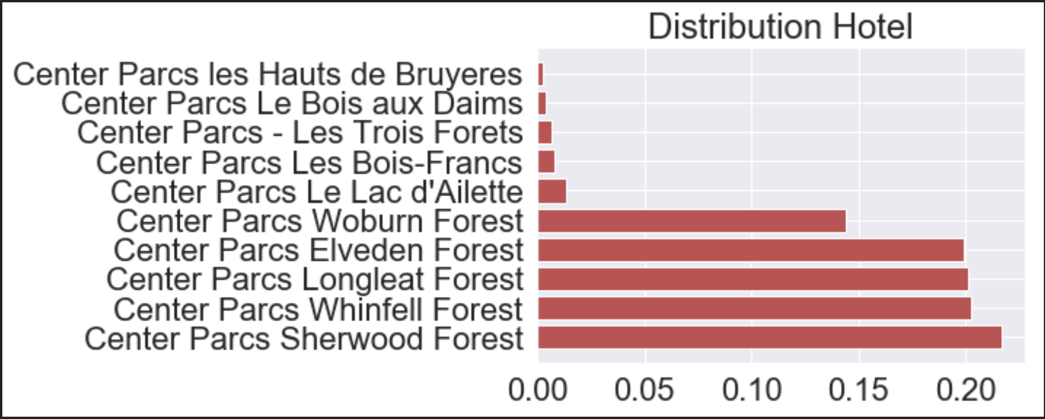
Descriptive Statistics
Total Observations : 49282
Main variables : Review, Review_id, Topics, Topics_sentiment

Slide 13
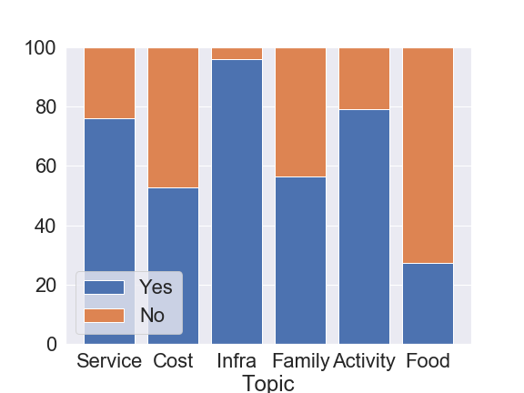
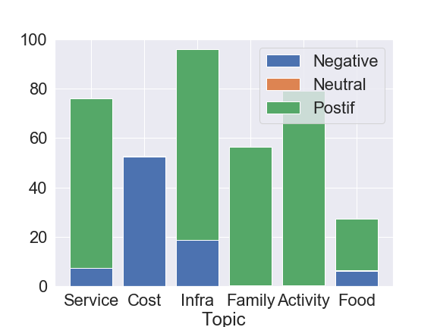
Topics’ Presence and Topics Sentiment Distribution

Slide 14
Hierarchisation results
T-Statistics and Counts
YES: 3.98
NO : 4.35
Service
≈37000
≈ 12000
1: 4.16
-1 : 3.34
≈33000
≈ 3700
YES: 3.83
NO : 4.34
Topics | % of cited
Activities | ≈ 80
Cost | ≈ 53
Family | ≈ 52
Food + | ≈ 20
Food - | ≈ 7
Service + | ≈ 67
Service - | ≈ 8
Infra + | ≈ 77
Infra - | ≈ 18
Cost
≈26000
≈ 23000
1: 4.7
-1 : 3.82
≈95
≈ 26000
YES: 4.05
NO : 4.43
Infra
≈47000
≈ 2000
1: 4.36
-1 : 2.79
≈38000
≈ 9000
YES: 4.28
NO : 3.79
Family
≈27000
≈ 22000
1: 4.29
-1 : 3.79
≈27000
≈ 79
YES: 4.08
NO : 4.06
NS: p-value = 0.065
Food
≈13400
≈ 35600
1: 4.36
-1 : 3.15
≈10000
≈ 3400
YES: 4.25
NO : 3.38
Activities
≈39000
≈ 10000
1: 4.25
-1 : 2.77
≈38000
≈ 75

Slide 15
Hierarchisation results
 | ELVEDEN | LONGLEAT | SHERWOOD | WHINFELL | WOBURN
Activities | 77.8 | 79 | 76.2 | 79.9 | 84.9
Cost | 53.5 | 53.2 | 53.9 | 53.3 | 49.2
Family | 56.2 | 54.9 | 57.5 | 59.6 | 52.6
Food + | 21.4 | 19.1 | 20.6 | 20.9 | 21.9
Food - | 6.9 | 6.03 | 6.5 | 5.9 | 6.02
Service + | 66.3 | 67.3 | 68.4 | 68 | 73.8
Service - | 9 | 7.9 | 7 | 6.9 | 5.6
Infra + | 74.2 | 76.9 | 75.5 | 79.5 | 81.4
Infra - | 20.3 | 19.8 | 18.9 | 16.6 | 16.7
Avg_Rating | 4.04 | 4.05 | 4.09 | 4.20 | 4.01
4.26
4.24
4.28
4.38
4.14
3.82
3.78
3.84
3.97
3.76
4.28
4.27
4.31
4.40
4.16
4.34
4.36
4.42
4.45
4.31
3.15
3.17
3.19
3.34
2.94
4.15
4.14
4.19
4.28
4.12
2.37
2.26
2.28
2.36
2.25
4.37
4.36
4.39
4.46
4.25
2.78
2.79
2.79
2.87
2.84

Slide 16
Hierarchisation results
BenchMark
 | ELVEDEN | LONGLEAT | SHERWOOD | WHINFELL | WOBURN
Activities | 77.8 | 79 | 76.2 | 79.9 | 84.9
Cost | 53.5 | 53.2 | 53.9 | 53.3 | 49.2
Family | 56.2 | 54.9 | 57.5 | 59.6 | 52.6
Food + | 21.4 | 19.1 | 20.6 | 20.9 | 21.9
Food - | 6.9 | 6.03 | 6.5 | 5.9 | 6.02
Service + | 66.3 | 67.3 | 68.4 | 68 | 73.8
Service - | 9 | 7.9 | 7 | 6.9 | 5.6
Infra + | 74.2 | 76.9 | 75.5 | 79.5 | 81.4
Infra - | 20.3 | 19.8 | 18.9 | 16.6 | 16.7
Avg_Rating | 4.04 | 4.05 | 4.09 | 4.20 | 4.01
4.26
4.24
4.28
4.38
4.14
3.82
3.78
3.84
3.97
3.76
4.28
4.27
4.31
4.40
4.16
4.34
4.36
4.42
4.45
4.31
3.15
3.17
3.19
3.34
2.94
4.15
4.14
4.19
4.28
4.12
2.37
2.26
2.28
2.36
2.25
4.37
4.36
4.39
4.46
4.25
2.78
2.79
2.79
2.87
2.84

Slide 17
Agenda
Semi-supervised recap
Data to business transition
Business workshop
Agile methodology
Conclusion

Slide 18
Your final restitution : the business case
The objective of the mission is to help the client lead with data-driven decisions.
What is the key value driver for your CenterParc?
1
2
3
Identify the key value driver and provide KPIs to track (ex : average order value, net promoter score)
Estimate for each driver the costs and benefits, quantifiable and non quantifiable
Define a strategy and KPIs to track for goals

Slide 19





The business case
A business case is the rational measure of the benefits a client can achieve by embarking on the transformation journey.
Strategic Scoping
Data Analysis
Top-Down B-case
Bottom-Up B-case
Benefits Tracking
Understand the business model
Develop hypothesis
Identify focus for stream diagnostics : value drivers
Select costs and benefits drivers
Quantify preliminary volume of benefits
Estimate the effect on the profit and loss (P&L)
Present Benefit opportunities
Select a value driver to prioritise and define next steps
Define KPIs to Track for Benefits

Slide 20
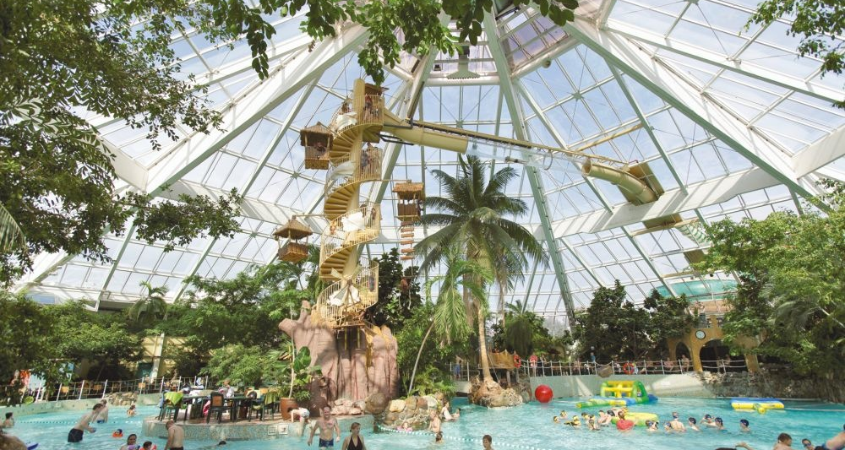
Case study
Identification of the themes and priorities per location to make Center Parcs a favorite holiday place in Europe

Slide 21
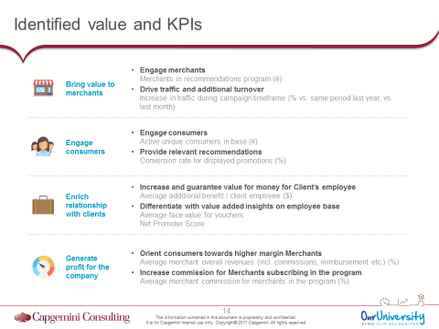
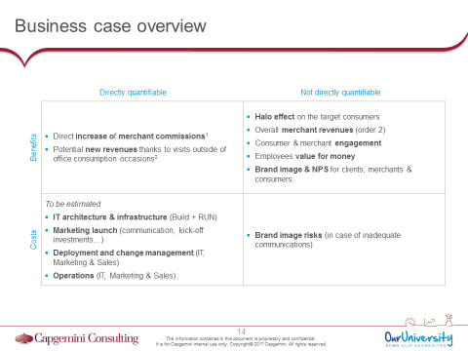
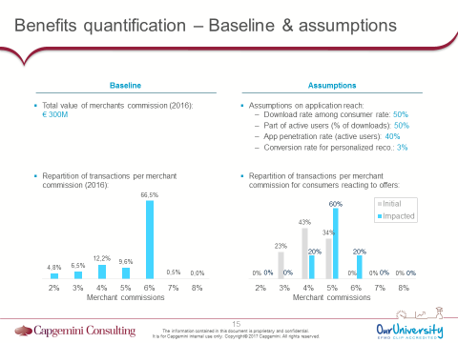
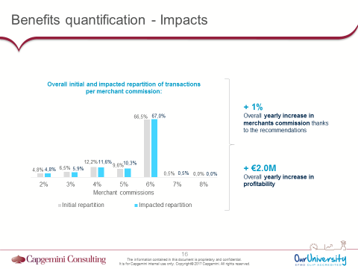
3 key deliverables
ILLUSTRATION
ILLUSTRATION
ILLUSTRATION
1. Identified value streams & associated KPIs
2. Benefits & costs matrix
3. Benefits & costs quantifications

Slide 22
Deliverable #1: Identified value stream and associated KPIs
ILLUSTRATION
Identification of the value brought the different stakeholders (internal and external) by the considered use case
1
2
1
For each of the stakeholders, finding of:
The impacts of the value brought
The KPIs enabling the measure them
2

Slide 23

Deliverable #2: Benefits and costs matrix
ILLUSTRATION
Identification of the directly quantifiable benefits and costs (e.g. additional sales in volume, cross / up-sell, implementation and roll-out costs…)
1
2
1
Identification of the benefits and costs that are not directly quantifiable (e.g. engagement, satisfaction, brand image, technological risks…)
2

Slide 24


Deliverable #3: Benefits and costs quantification
Baseline identification & quantification (modeling of as-is revenue / cost structures if nothing changes)
ILLUSTRATION
1
1
2
ILLUSTRATION
Impacts of the use case – assumptions and impacted baseline
3
2
Overall impacts on costs and revenues (difference between impacted baseline and initial baseline)
3

Slide 25



How to structure and deliver data projects?
40’
This workshop aims to make you discover how to transform information into insights in order to generate value
Objective:
Transform the results produced throughout the course into insights (an insight is an information which helps to take a decision / action to generate value)
Organization:
Each group selects a site on which he will conduct the analysis
Total workshop duration: 45 min. (i.e., 35 min. of production & 2 x 5 min. of presentation)
Value drivers:
Based on the identified topics, describe the main value drivers (how will your project generate value?)
Rank value drivers for the selected site
Synthesis of produced results:
Identify results produced by your algorithms which can be used to generate insights (topics, subject of comments, frequency of comments, sentiment, etc.)
Insights:
Identify the main topic of the selected site and the related value drivers
Imagine indicators, KPIs, graphs, recommendations, etc. based on the listed results
Describe how Business Rep. can use these insights to take actions to activate the target value drivers

Slide 26
Agenda
Semi-supervised recap
Data to business transition
Business workshop
Agile methodology
Conclusion

Slide 27

How to structure and deliver data projects?
The delivery model is based on a progressive approach to ensure the correct product delivery
2 – 3 weeks
Low investment
Go / No go
2 – 4 weeks
Medium investment
Go / No go
X * 4-week sprints
High investment
Scoping / Qualification
Sprint 0
Delivery
…
…
Is the project mature enough?
Is everything ready to launch the project?
Delivery of the data product
PoC / PoV
If necessary, launch of a PoC / PoV to prove the project feasibility / value

Slide 28
How to structure and deliver data projects?
5’
Which questions should be answered during the Scoping / Qualification phase to ensure the project is mature enough to be launched?

Slide 29
How to structure and deliver data projects?
Scoping / Qualification phase
Business
Organization
Use case description
What do we want to achieve, how do we want to do it, what will be the impact?
Who are the end users?
What has already been done?
Business case
What is the expected gain & requested budget?
People
Who is the Product Owner?
Who are the Sponsors and Business Representatives?
Planning
What is the overall roadmap?
Data
Technology
Data requirement
What are the requested data / data sources? Who manage them?
What is the scope of the requested data?
What is the requested refresh rate?
Data usage
Are there any potential legal or business issues?
Use Case development
What are the foreseen data science approaches to be deployed?
What are the required technical skills?
Technical environment
What are the technical features to be implemented?
What is the required technical environment?

Slide 30
How to structure and deliver data projects?
5’
Which tasks must be performed during the Sprint 0 to ensure everything is ready to start your project delivery?

Slide 31
How to structure and deliver data projects?
Preparation phase (sprint 0)
Business
Organization
Use case description
Product design (Mock-ups)
Product detailed description (backlog)
Business case
Business case (to be detailed during delivery)
Value tracking indicators
People
Delivery team mobilization
Business & Technical sponsors & experts on-boarding and engagement
Planning
Delivery roadmap
Data
Technology
Data requirement
Critical data ingestion
Technical & Business quality check, scope analysis of ingested data
Data usage
Legal & Business approval to use data
Data science approach
Detailed approach for each complex features
Technical environment
Platform set-up
Development best practices

Slide 32
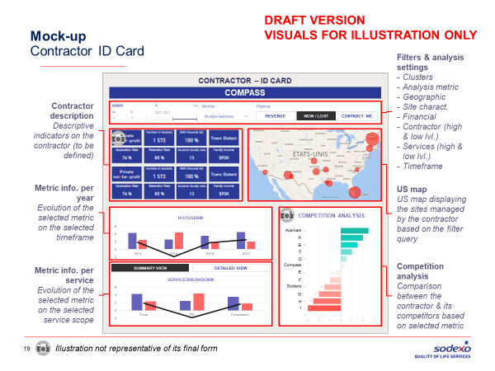
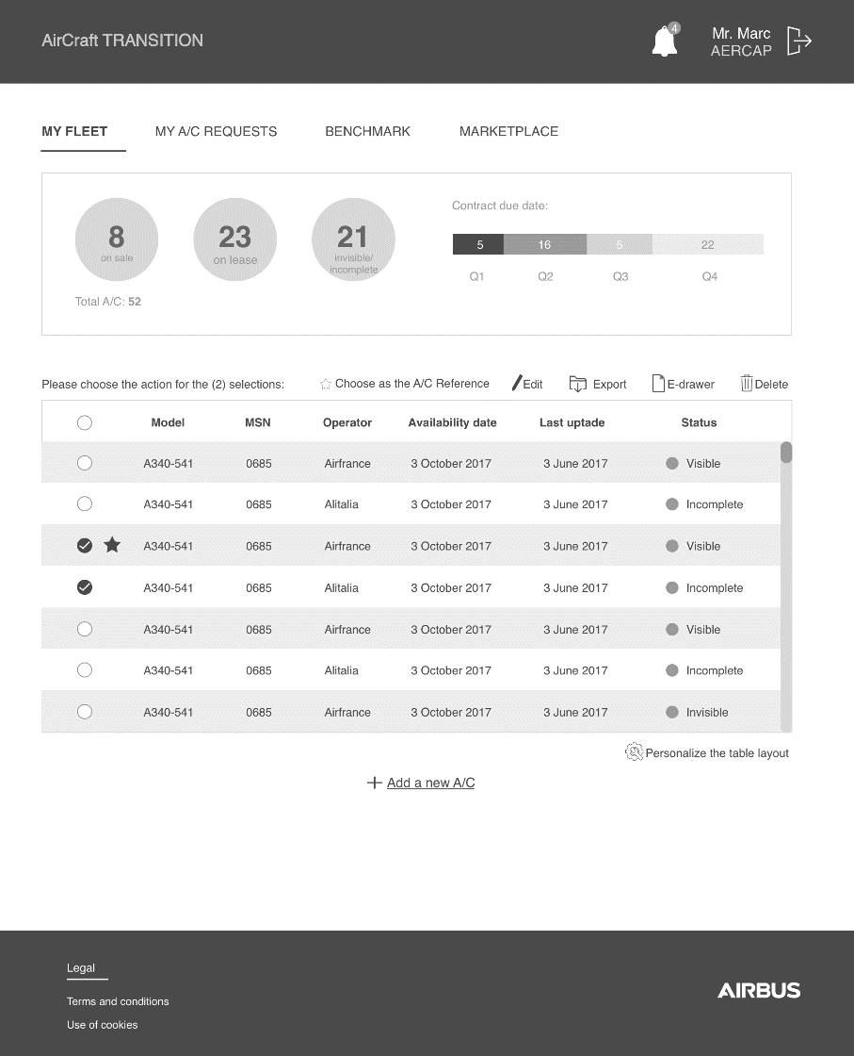
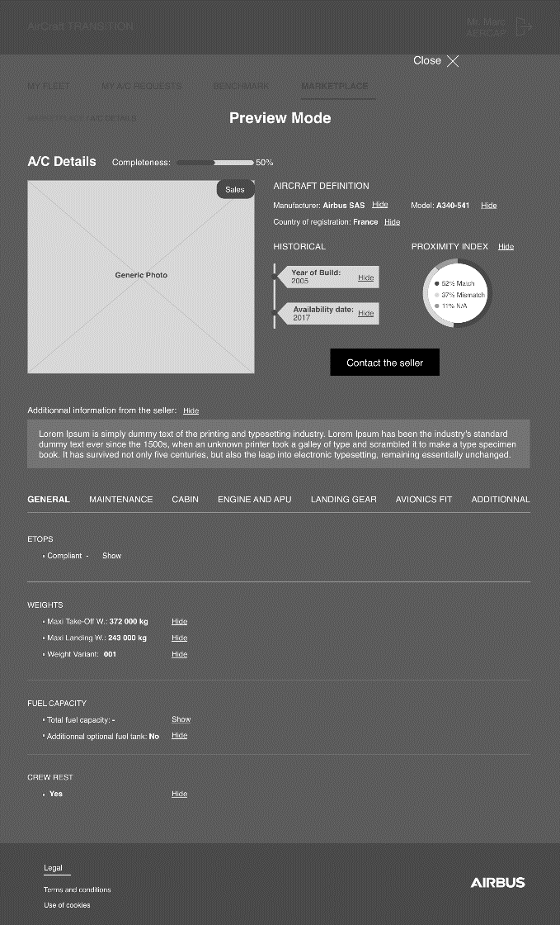
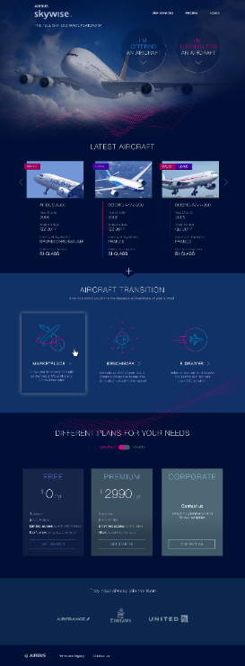

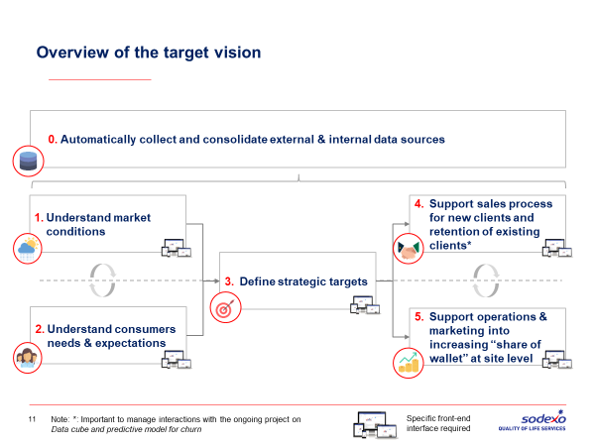
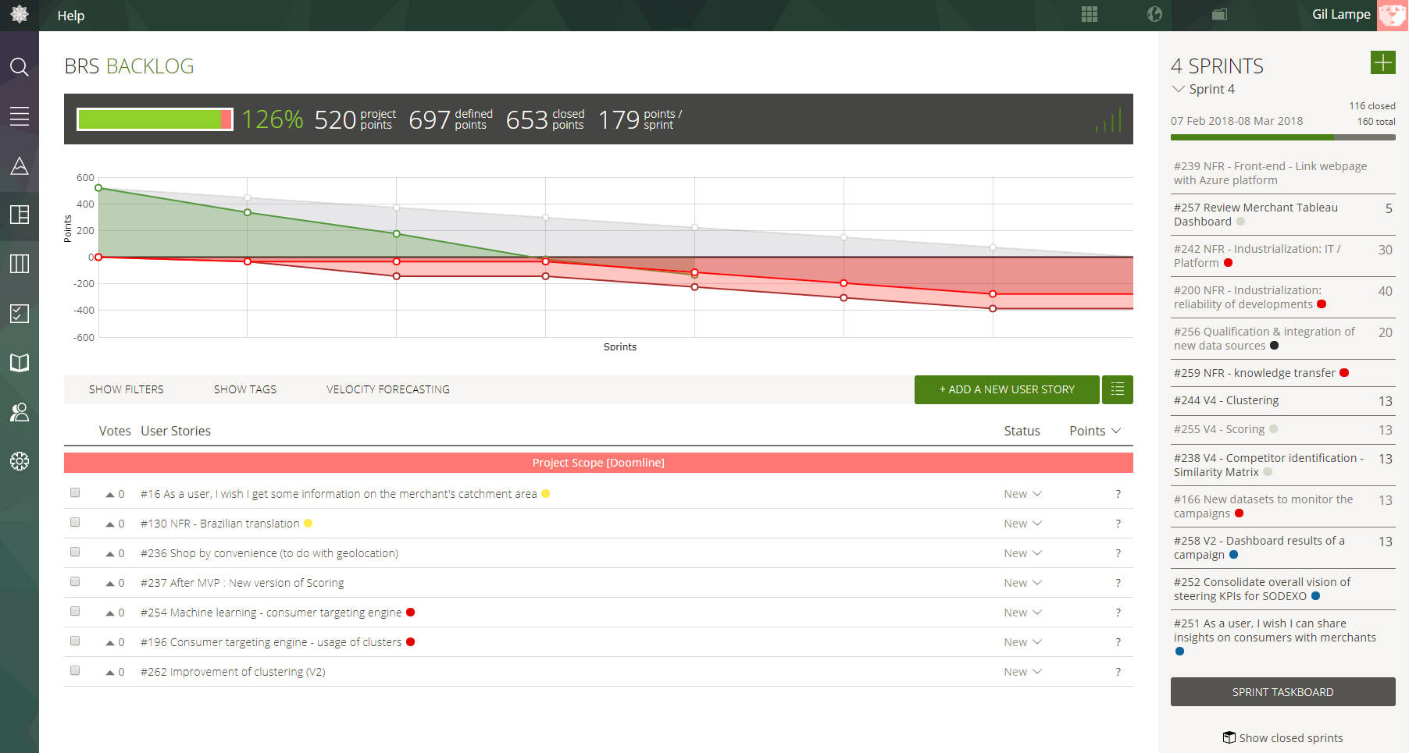
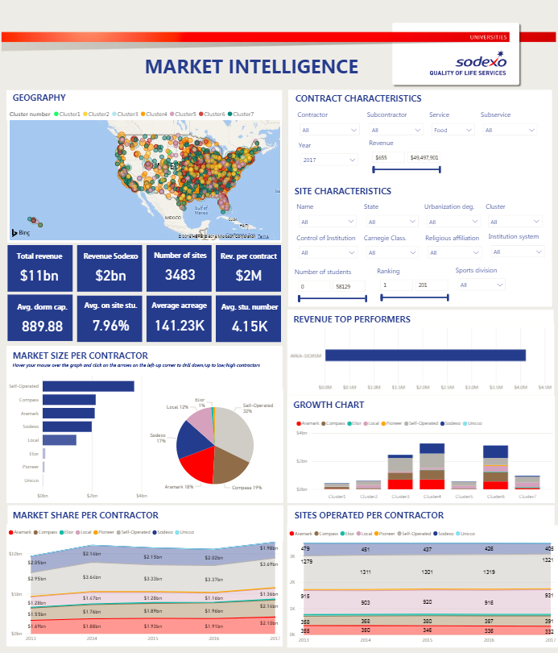
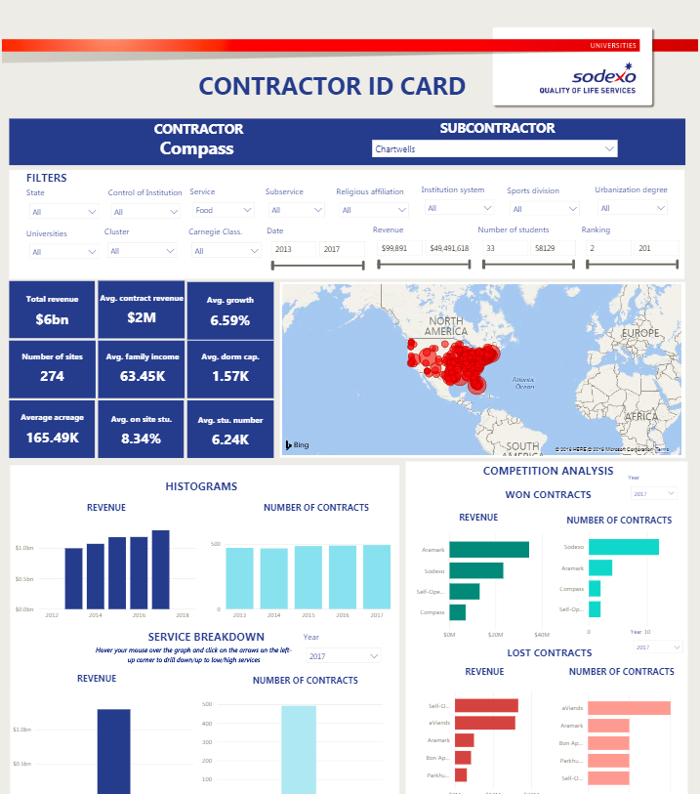
How to structure and deliver data projects?
Key deliverables
Mock-up (functional)
Wireframe (UX designer)
Mock-up (UI designer)
Sprint 0
Delivery Sprint
Functional desc.
Product backlog
Minimum viable product

Slide 33
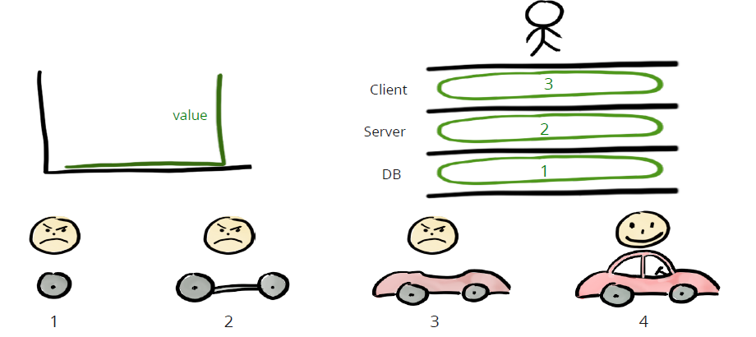
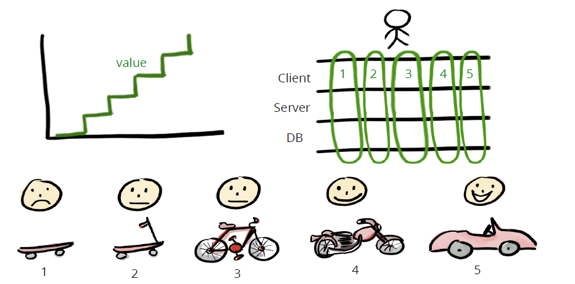
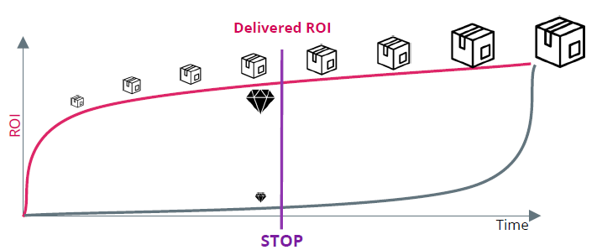
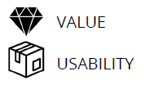
How to structure and deliver data projects?
Agile-Scrum methodology: the delivery principles
Traditional method Product will work and bring value only at final step
Agile method Features are available for users as soon as tested
If project is stopped halfway
Less than 50% of value is delivered and nothing is working
~80% of value is delivered and is fully available for end users

Slide 34







How to structure and deliver data projects?
Agile-Scrum methodology: the delivery team
The delivery team
The support team
Data Scientist
Data Engineer
Sponsors
Ensure the involvement of the support functions
UX Designer
Front developer
Scrum Master
Business experts
Help to design the product, validate its value
Product Owner
Delivery
team
System Engineer
Technical experts
Support the delivery team on all the tech. aspects
Indus. team
Take over and deploy the product once done
Business
Technology

Slide 35

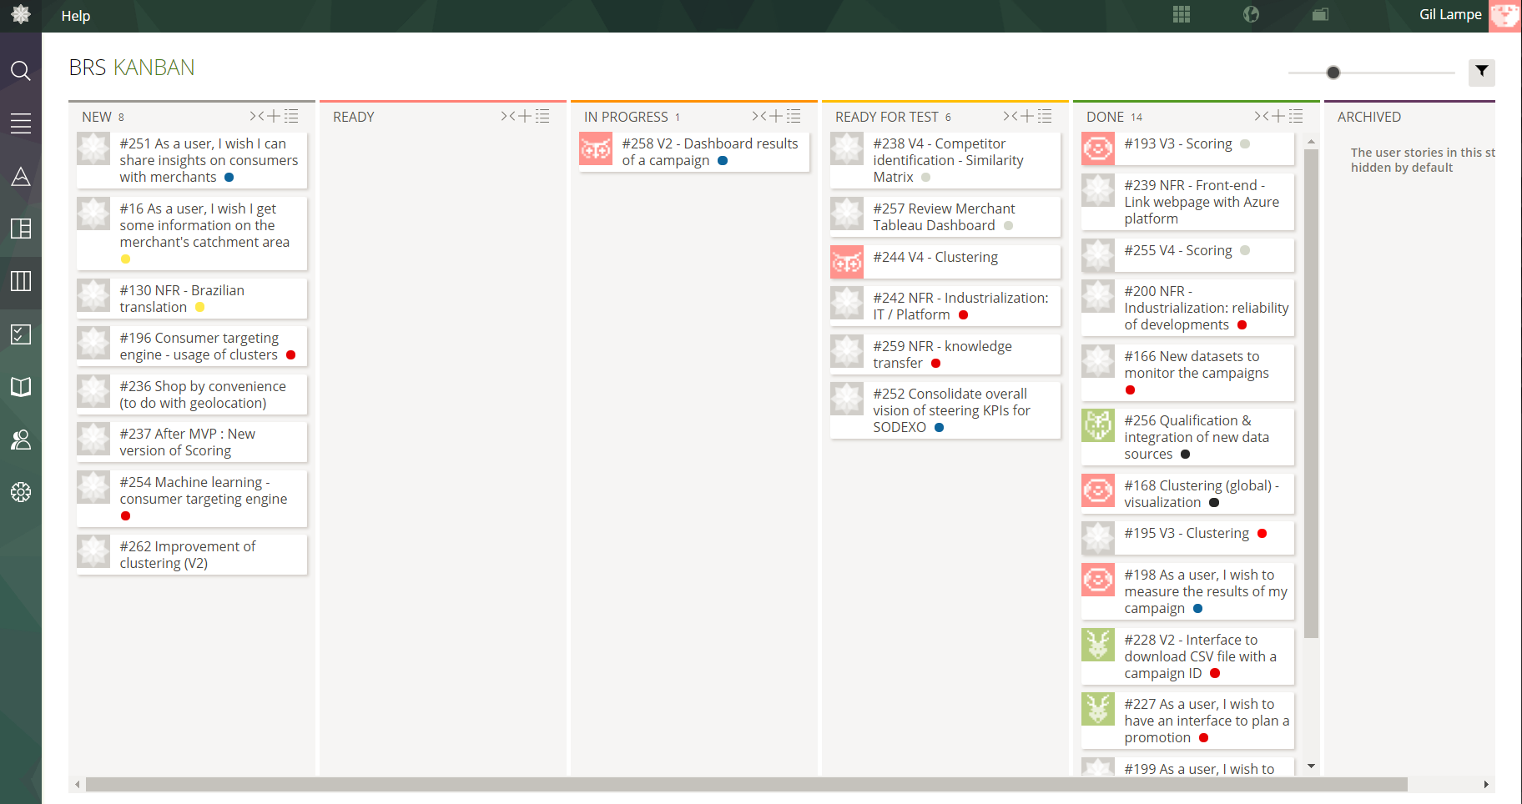

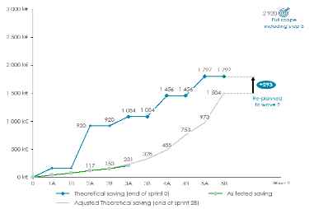
How to structure and deliver data projects?
Agile-Scrum methodology: the delivery organization
Sprint planning
Sprint demo & retrospective
User story
As a user (type of user)
I want (functional exp.)
so that (outcome)
Prioritized by value & workload
2 to 4-week sprint
Backlog grooming
Daily stand-up meetings
Data preparation
User story ready
Iteration 1, 2, 3…
User story done
Definition of ready
As a developer, I agree to include a US in a sprint when it meets the following conditions
Business understanding
Data exploration
Modeling / Prototyping
Deployment
Evaluation & interpretation
Definition of done
As a PO, I consider that a US is delivered when it meets the following conditions
Product backlog to express business needs
Agile rituals to organize delivery activities
Value tracking based on delivery

Slide 36
Agenda
Semi-supervised recap
Data to business transition
Business workshop
Agile methodology
Conclusion

Slide 37

Today we learnt
Descriptive statistics
Business approach
How to hierarchize topics
How to extract business KPIs from data
Machine Learning can is not just a technical step but a real part of the business development
Know what is a business case $
… and how is it linked to business decisions
… how to go from data to insight and to actions
Know how to fill the main deliverables
… and how to run a project in an agile way

Slide 38

Work for next week
Final restitution
Prepare a presentation which sum up what you discovered about Center Parcs.
You’ll be talking to Center Parc CEO who is willing to make Center Parc the best place for your holidays.
You’ll be presenting your whole data strategy.
You’ll present your recommendations to change parcs based on the identified insights.
Prediction Challenge
Given TripAdvisor reviews on Novotel resorts, you have to create a model which will predict the rating. You are free to create your own NLP model.
We’ll send you the submission rules in a separated pdf.
This is a competition between the 12 groups. The three winners will be rewarded.

Slide 39
THANK YOU!

